Slide 1
Resources for the Blind Inventory System
Project Manager: Clarence Carillaga
Project Members: Pauline Gabrielle De Ocampo Phil Harvey Burgos
SOFTDEV IT111

Slide 2

Background of the Client
Resources for the Blind Inc. is a non-profit and non-government Christian organization that serves the visually-impaired people since 1988. They devoted themselves in removing the obstacles and providing services, training, and equipment needed in order for those who are visually-impaired to reach their fullest potential in life.

Slide 3
Background of the Project
Problem Statement:
Manual records of the Inventory
Existing Suppliers
Orders to Suppliers
Products
Solution:
Inventory System
Monitor daily transactions and orders
Store existing or new records
Generate reports

Slide 4
Background of the Project Cont’d
Accessibility:
For both sighted and visually impaired
Use of arrow keys
Tab button
Buttons with labels
Access keys

Slide 5
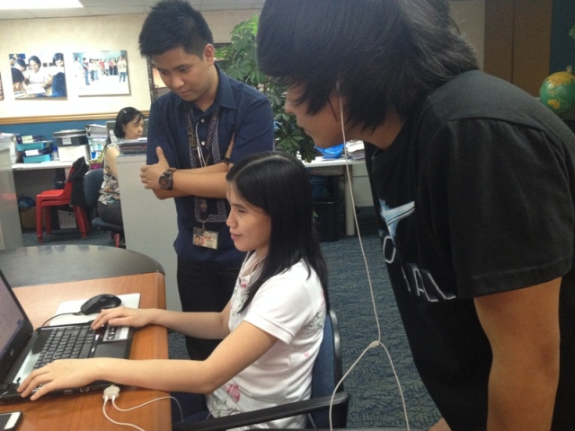
Review: Iteration 1

Slide 6
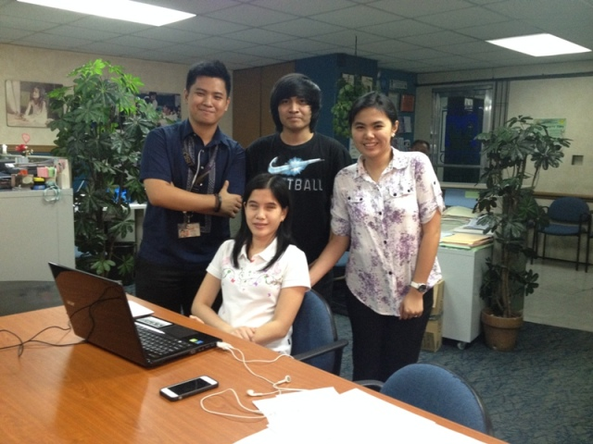
Review: Iteration 1
With Ms. Pia Resurreccion

Slide 7
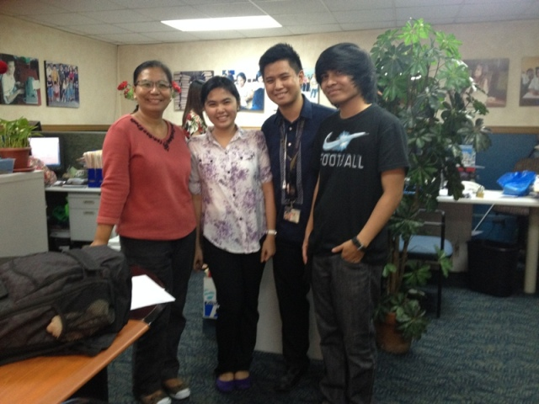
Review: Iteration 1
With Ms. Mayette Regala

Slide 8
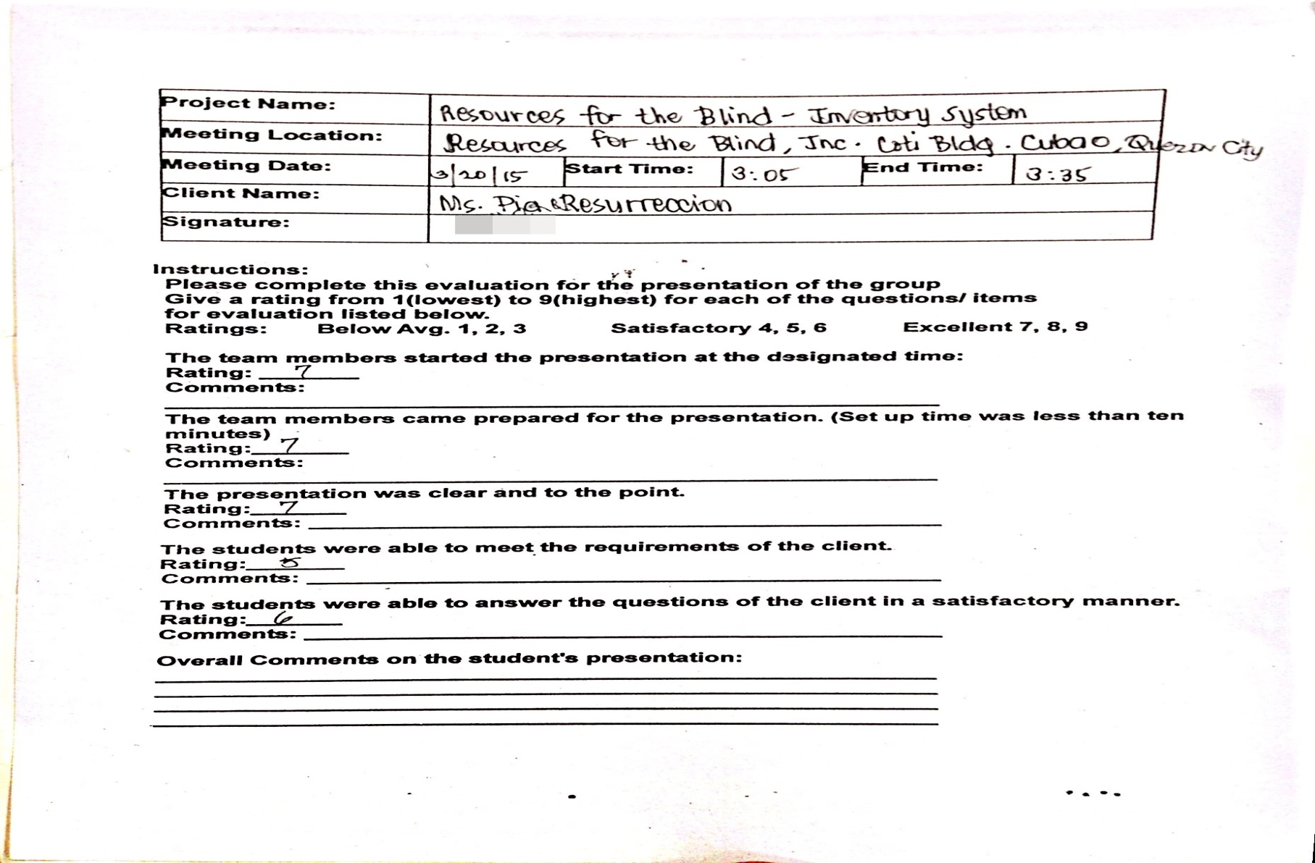
Review: Iteration 1
Ms. Pia’s Feedback

Slide 9
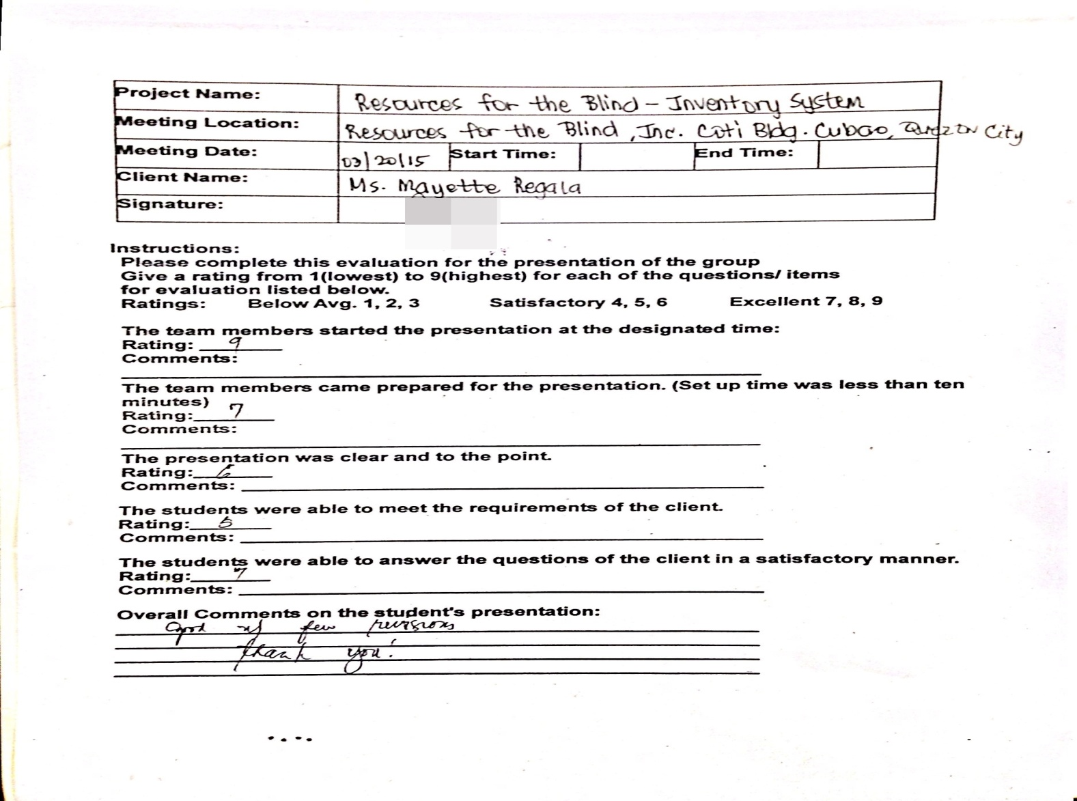
Review: Iteration 1
Ms. Mayette’s Feedback

Slide 10
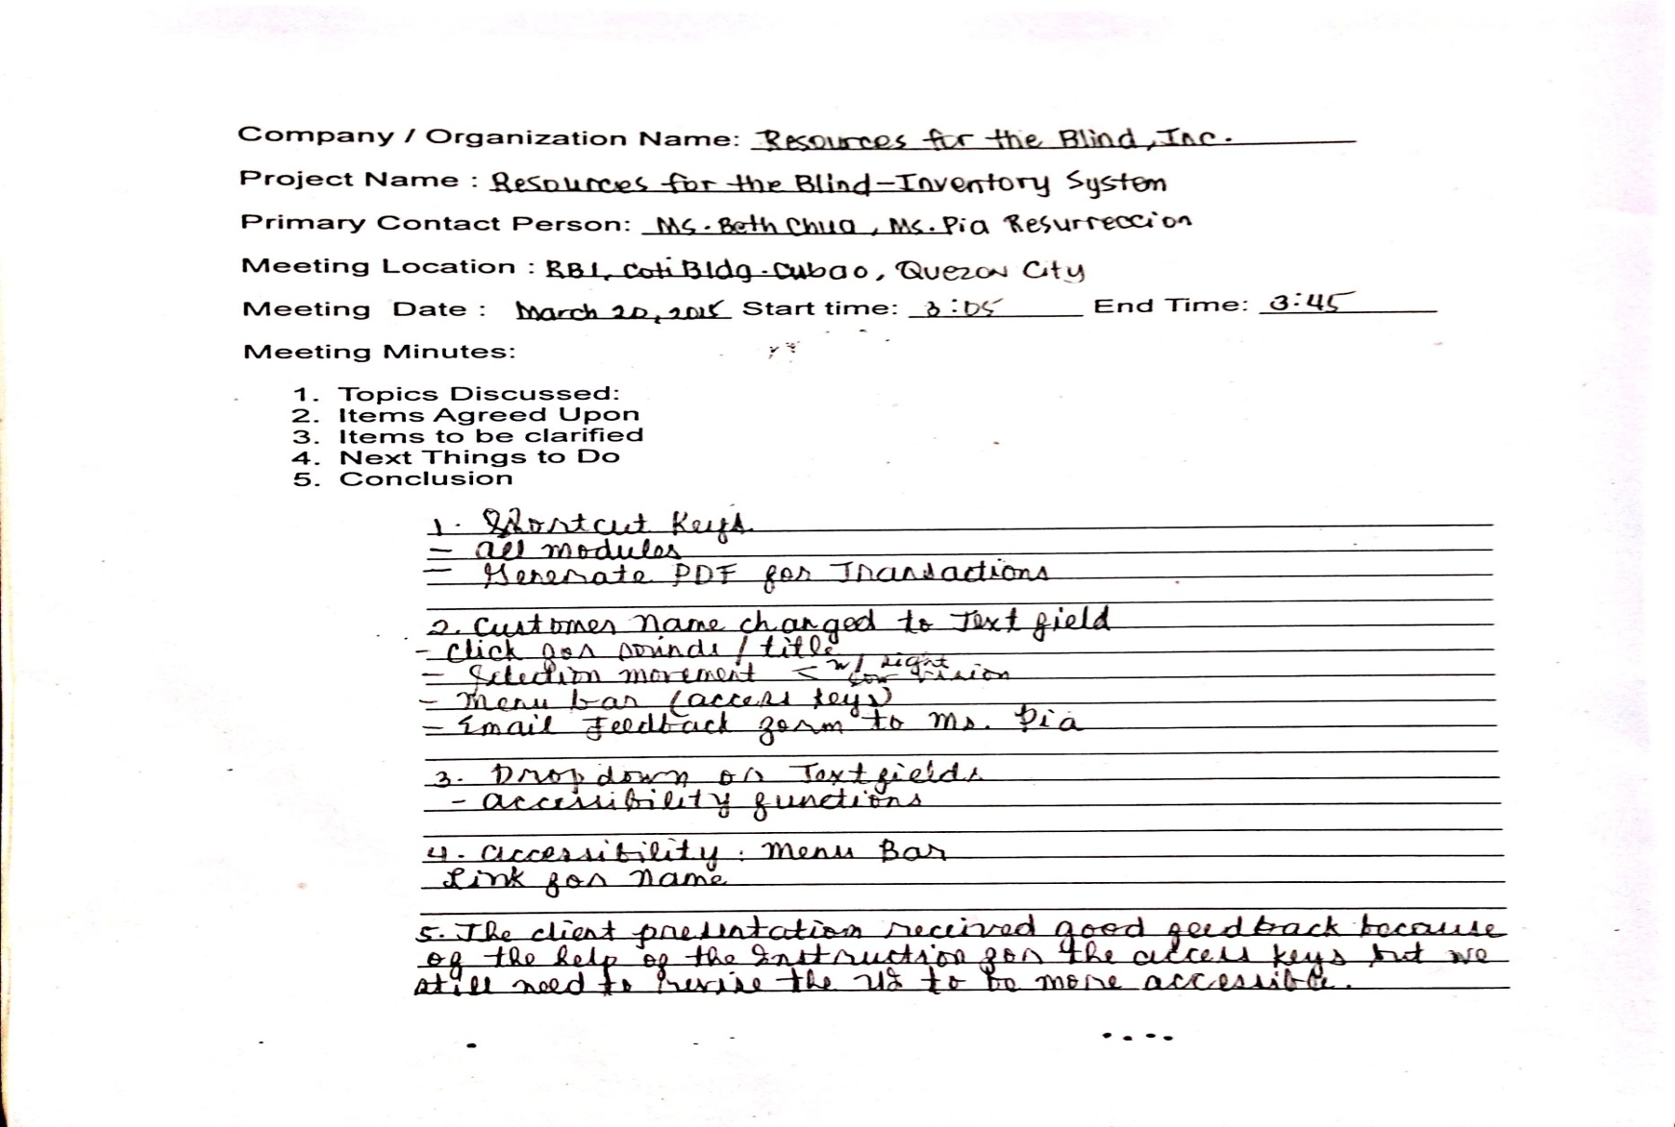
Review: Iteration 1
Minutes of the Meeting

Slide 11
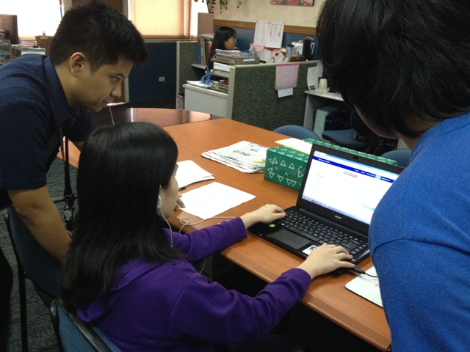
Review: Iteration 2

Slide 12
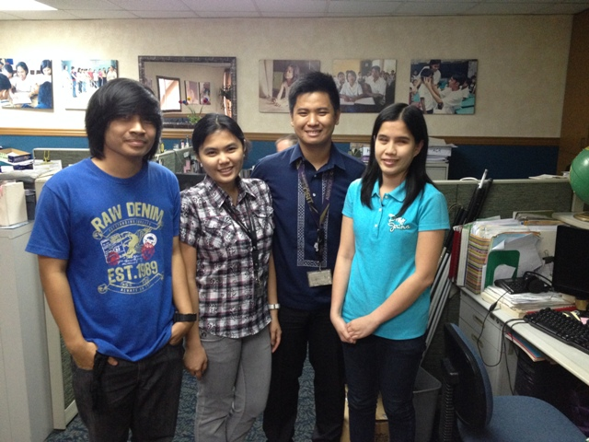
Review: Iteration 2
With Ms. Pia Resurreccion

Slide 13
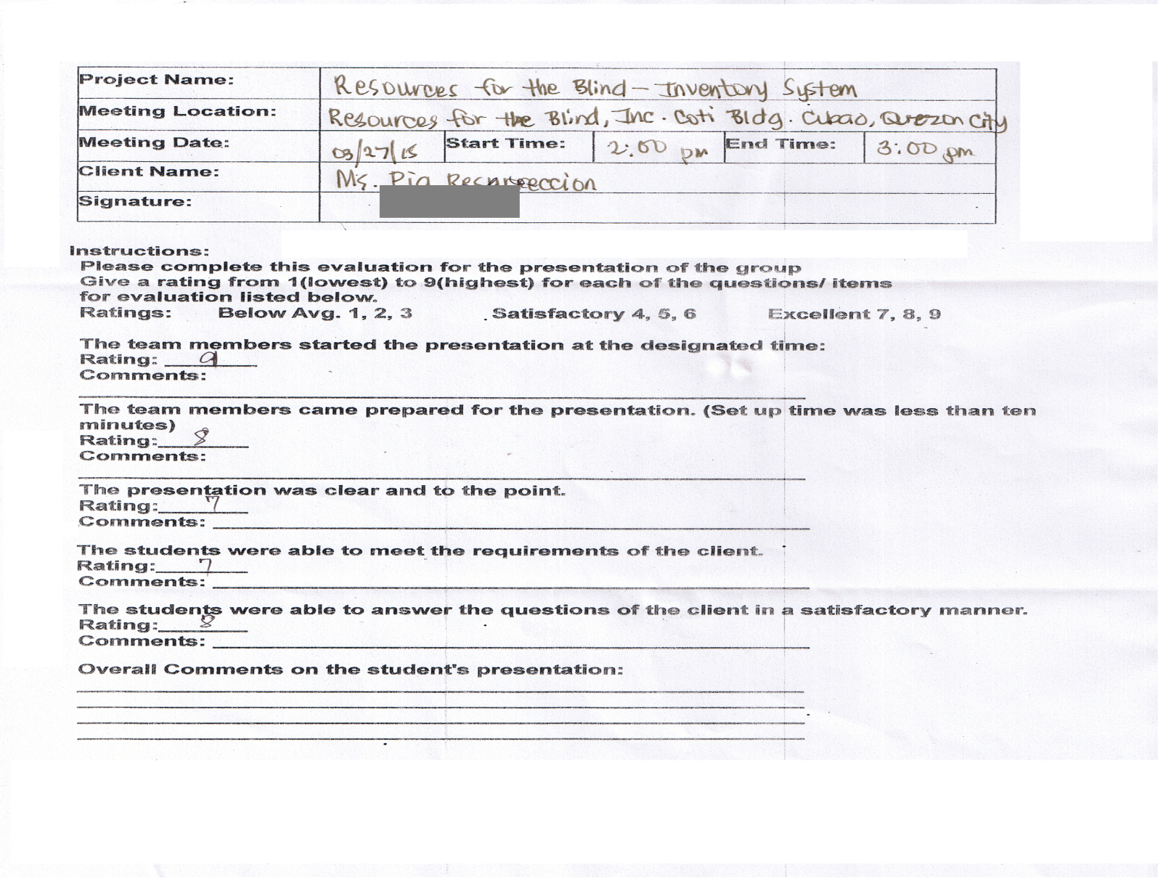
Review: Iteration 2
Ms. Pia’s Feedback

Slide 14
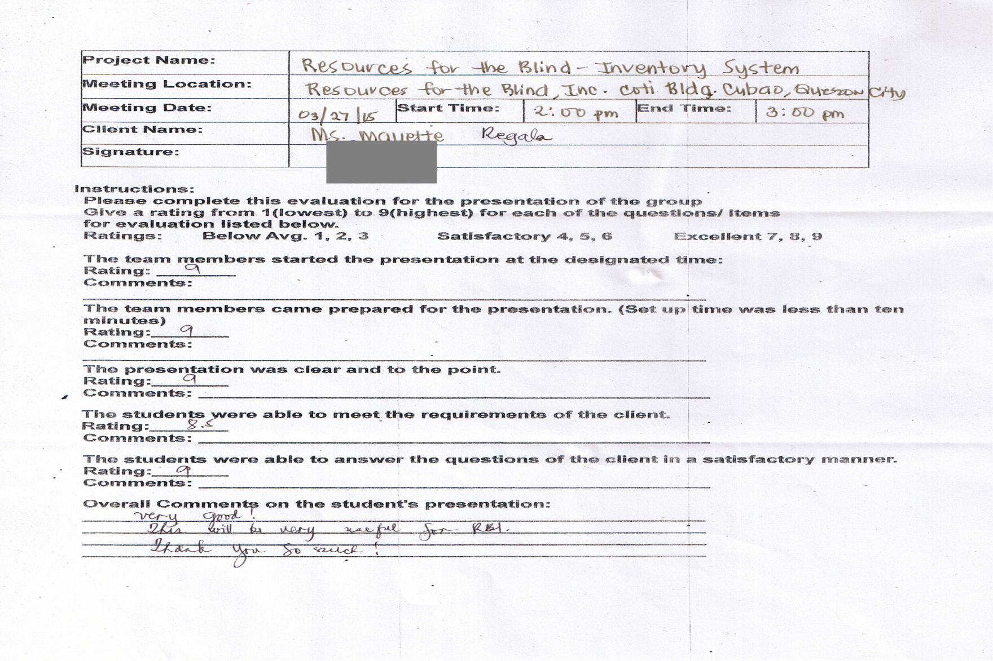
Review: Iteration 2
Ms. Mayette’s Feedback

Slide 15
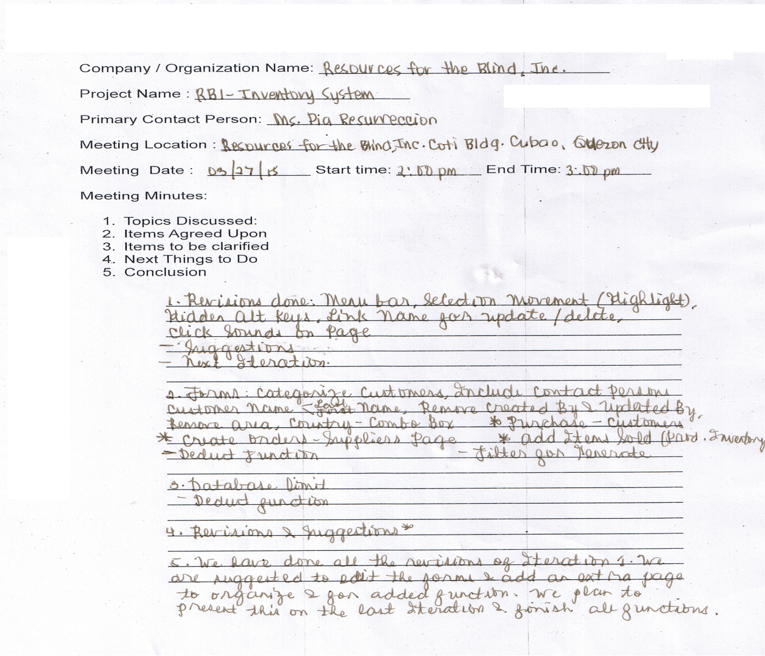
Review: Iteration 2
Minutes of the Meeting

Slide 16
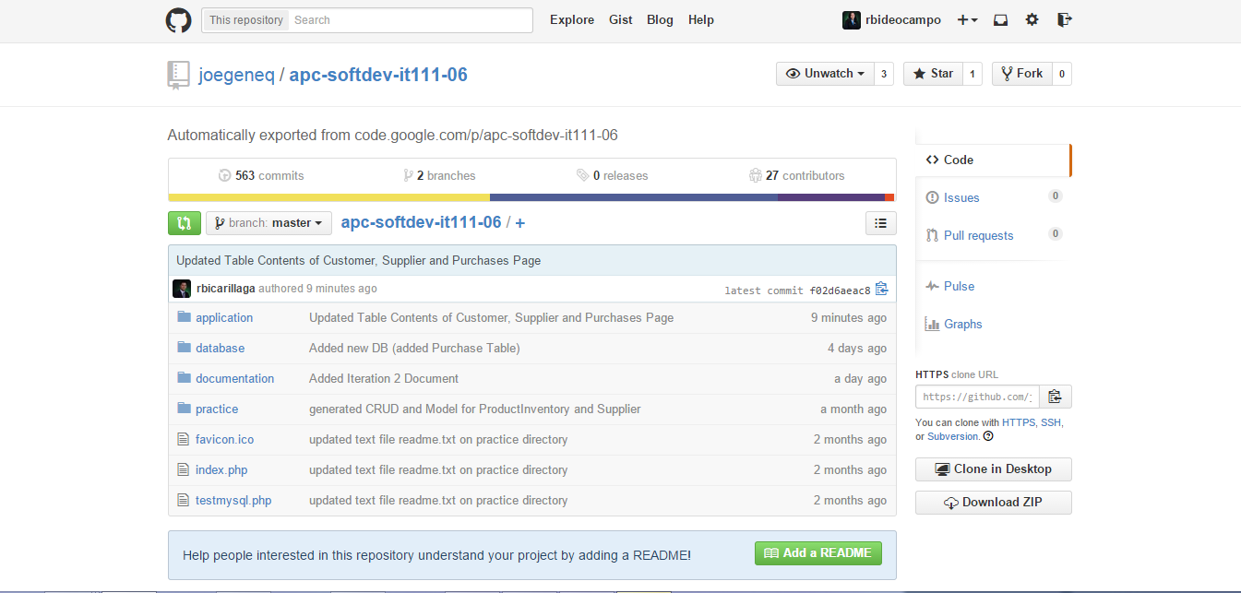
Github Project Repository CONTRIBUTIONS

Slide 17
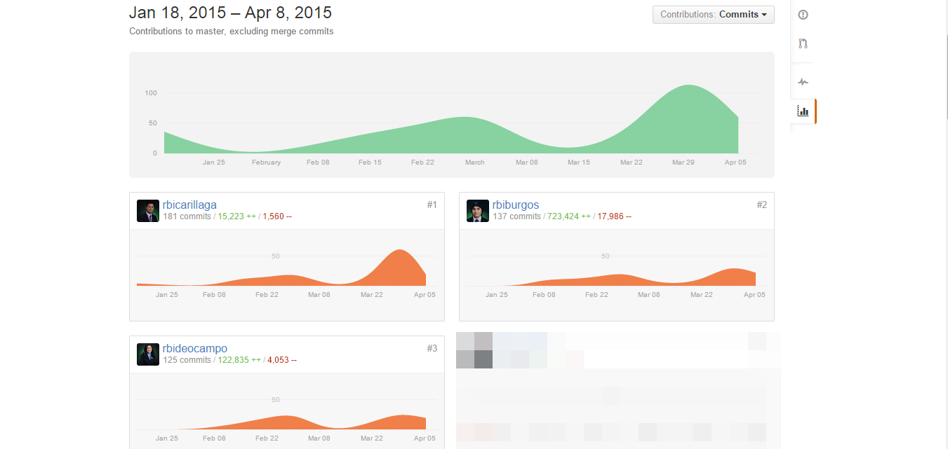
Github Project Repository CONTRIBUTIONS

Slide 18
Github Project Repository CONTRIBUTIONS
Individual Members Contributions:
Clarence:
UI Design
Access keys
Screenreader idea and download
Help page
Pauline:
Database design / structure
Calculated fields
Link Names
Dropdowns
Phil:
Generate Report
Manage
Log In
Session
Getting Started page

Slide 19
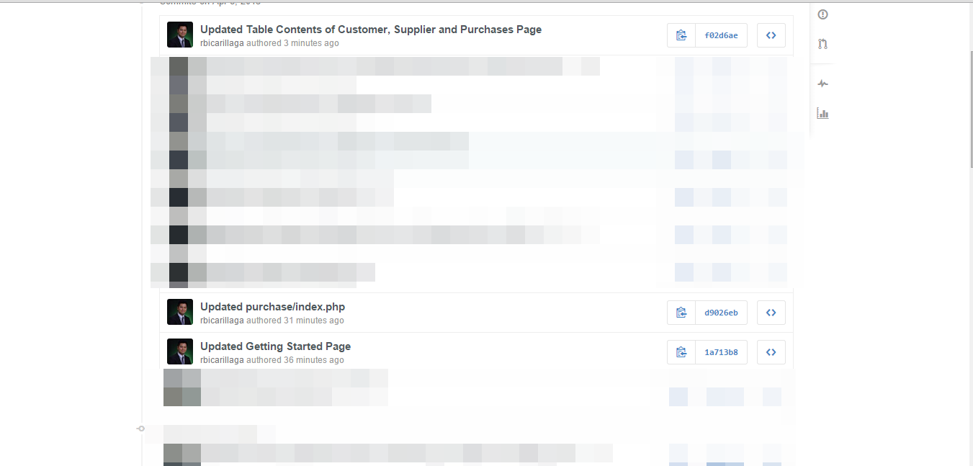
Github Project Repository CONTRIBUTIONS

Slide 20
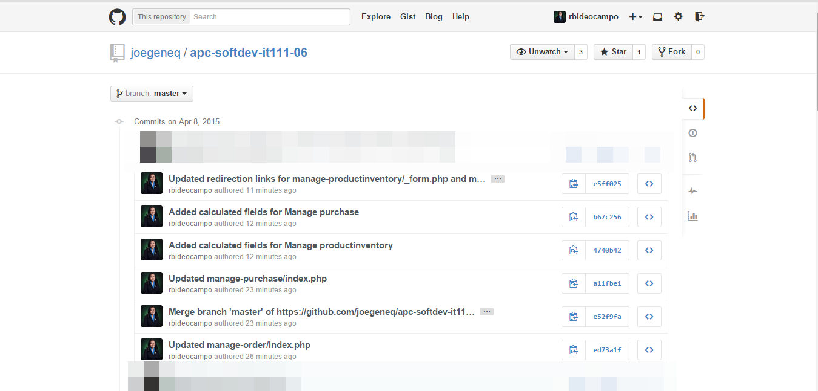
Github Project Repository CONTRIBUTIONS

Slide 21
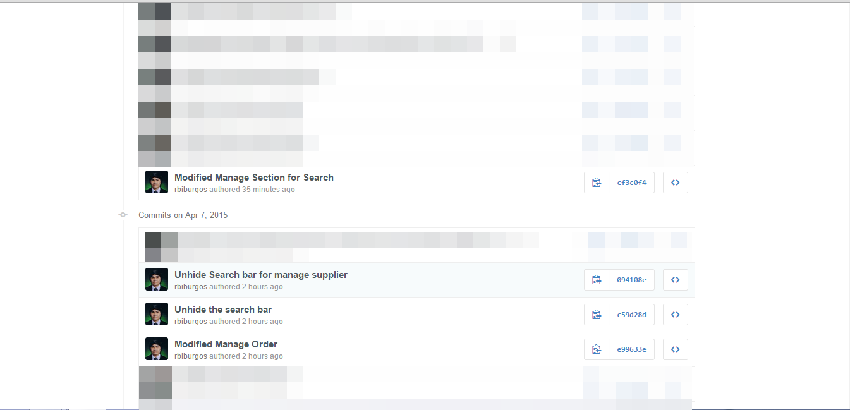
Github Project Repository CONTRIBUTIONS

Slide 22
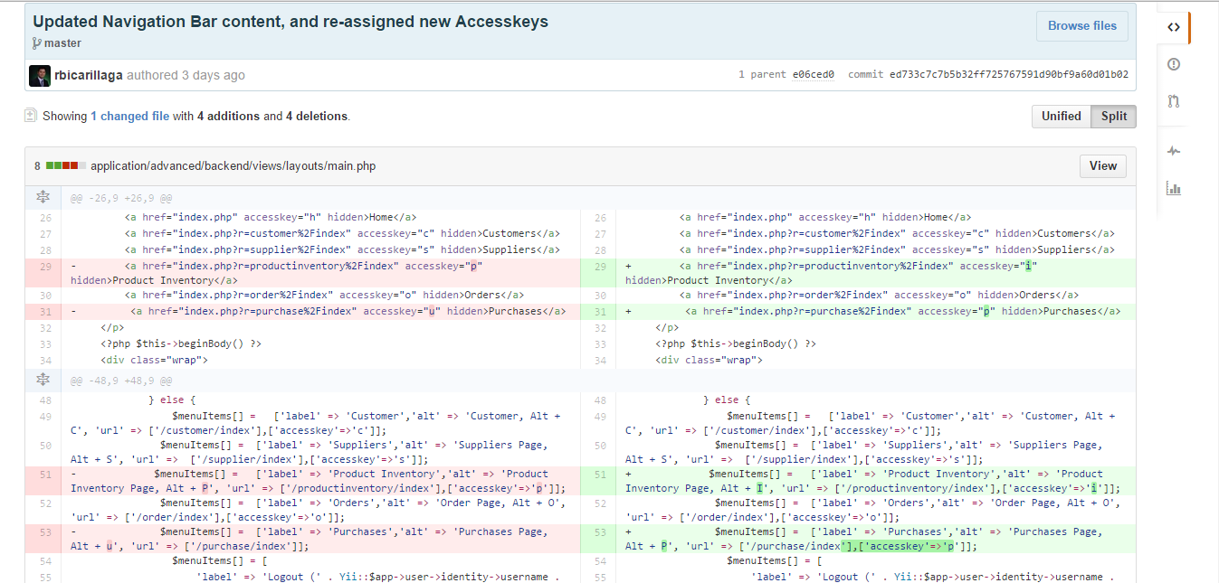
Github Project Repository CONTRIBUTIONS

Slide 23
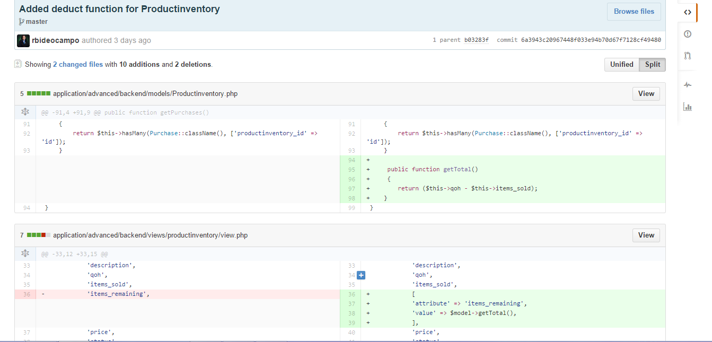
Github Project Repository CONTRIBUTIONS

Slide 24
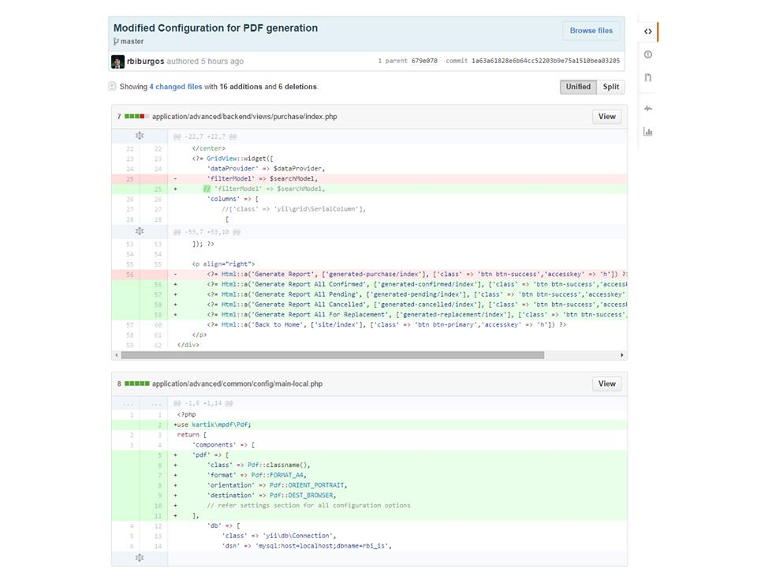
Github Project Repository CONTRIBUTIONS

Slide 25

Current Status of the Project
Percent Completed: 90%
Remaining work to be completed:
Filter for PDF Generation
Client Feedback regarding their interest in completing / implementing the project

Slide 26
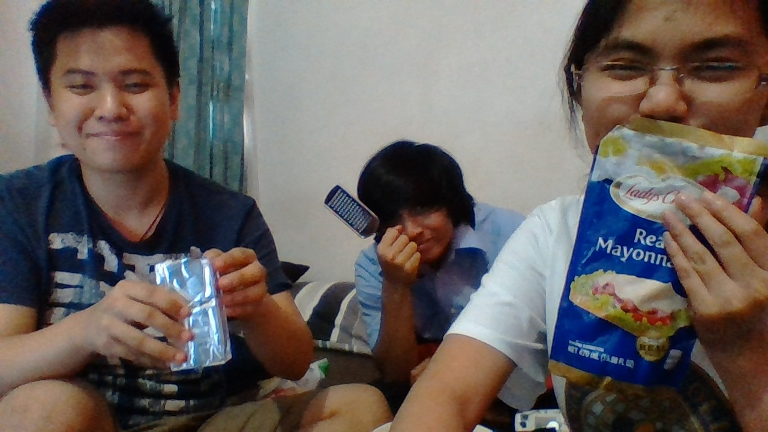
Next Steps
Do remaining work to be done
Final Presentation with the Client (Iteration 3)
Continue doing User Manual
Plans for continuing project

